Slide 1
PHYS4260 Quantum Mechanics II Spring 2025
Time-Independent Perturbation Theory

Slide 2
Outline
Weak Zeeman Effect
Strong Zeeman Effect
Intermediate Zeeman effect
Hyperfine structure of Hydrogen

Slide 3
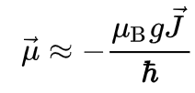
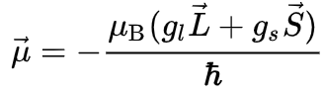
Re: The Zeeman Effect
To summarize: In a magnetic field, the perturbation term is
where $\vec{μ}$ is the magnetic moment of the atom. The magnetic moment consists of the electronic and nuclear parts; however, the latter is many orders of magnitude smaller and will be neglected here. Therefore,
where $μ_{B}$ is the Bohr magneton, $\vec{J}$ is the total angular momentum of the electron, and $g$ is the Landé g-factor, which we will later denote with $g_{J}$. We have seen that a more accurate approach is to take into account that the operator of the magnetic moment of an electron is a sum of the contributions of the orbital angular momentum $\vec{L}$ and the spin angular momentum $\vec{S}$ with each multiplied by the appropriate gyromagnetic ratio
Where $g_{l}=1$ and $g_{S}≈2.0023193$ (the latter is called the anomalous gyromagnetic ratio; the deviation of the value
from 2 is due to the effects of quantum electrodynamics).

Slide 4
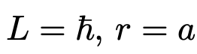
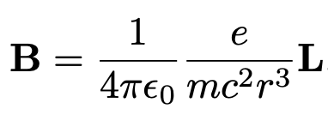
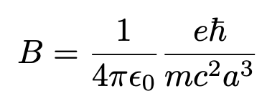
The Zeeman Effect
In the intermediate zone, where the two fields are comparable, we need the full machinery of degenerate perturbation theory, and it is necessary to diagonalize the relevant portion of the Hamiltonian “by hand.” In the following sections we shall explore each of these regimes briefly, for the case of hydrogen.
Weak-Field Zeeman Effect
Let’s quantify what weak means in the case of the hydrogen atom assuming
So, a “strong” Zeeman field is Bext ≫ 10 T, and a “weak” one is Bext ≪10 T. Incidentally, the Earth’s field (10^-4 T) is definitely weak.

Slide 5
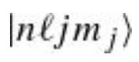
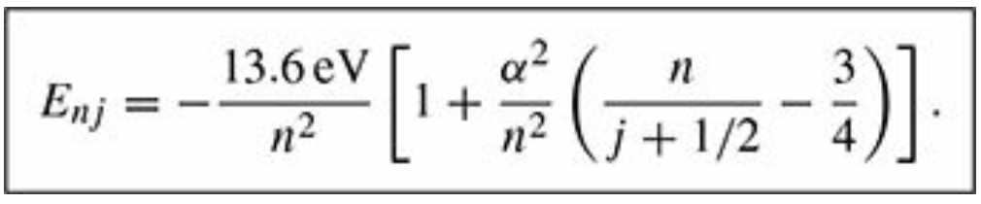
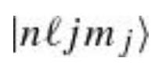
Weak-Field Zeeman Effect
$B_{ext}≪$ $B_{int}$ then fine structure dominates, $H_{Bohr}+H_{fs}^{′}$ is the unperturbed Hamiltonian and $H_{z}^{′}$ can be treated as a small perturbation.
The unperturbed eigenstates are then those appropriate to fine structure:
are the unperturbed energies
Even though fine structure has lifted some of the degeneracy in the Bohr model, these states are still degenerate, since the energy does not depend on $l$ and $m_{j}$.
$\left[H_{z}^{′},J_{z}\right]=0$ (so long as $B_{ext}$ is aligned with the z axis);
$\left[H_{z}^{′},L^{2}\right]=0$
That is, we do not need to evaluate the $W$ matrix for $H_{z}^{′}$ because is already diagonal.
Each of the degenerate states is uniquely labeled by the two quantum numbers $l$ and $m_{j}$.
are ``good states’’

Slide 6
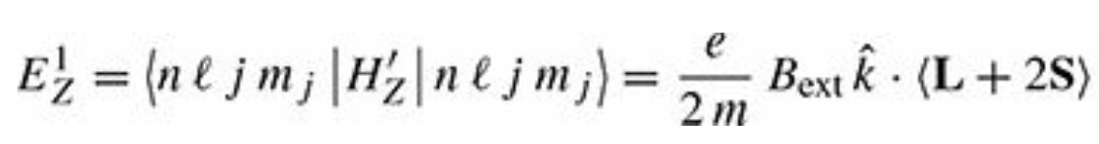
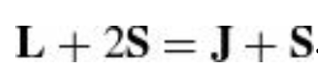
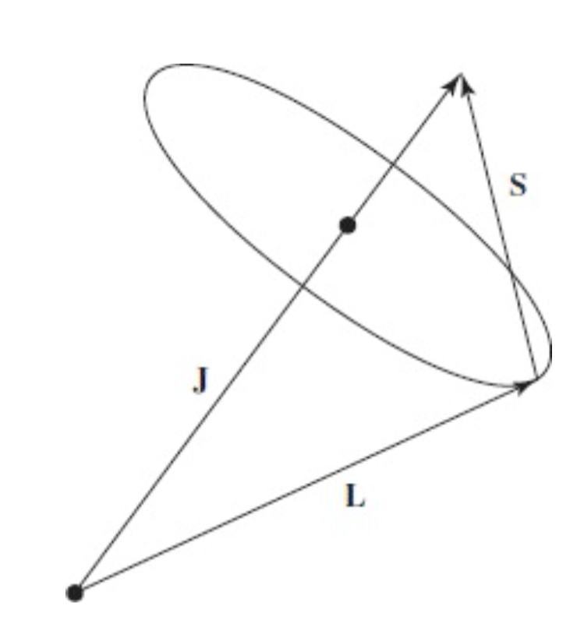
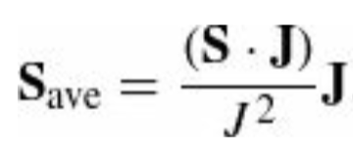
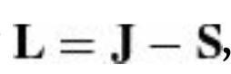
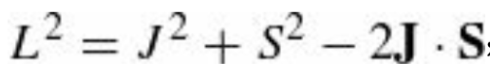
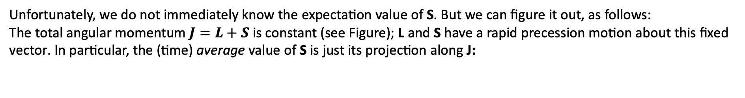
Weak-Field Zeeman Effect
In first-order perturbation theory, the Zeeman correction to the energy is
where, as mentioned above, we align $B_{ext}$ with the z axis to eliminate the off-diagonal elements of W. We observe that
Unfortunately, we do not immediately know the expectation value of S. But we can figure it out, as follows:
The total angular momentum $J=L+S$ is constant (see Figure); L and S have a rapid precession motion about this fixed
vector. In particular, the (time) average value of S is just its projection along J:
but
and

Slide 7
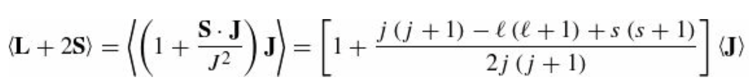
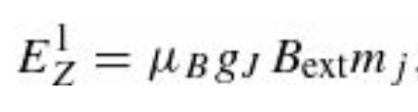
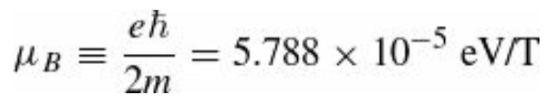
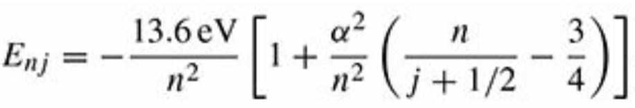
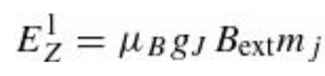
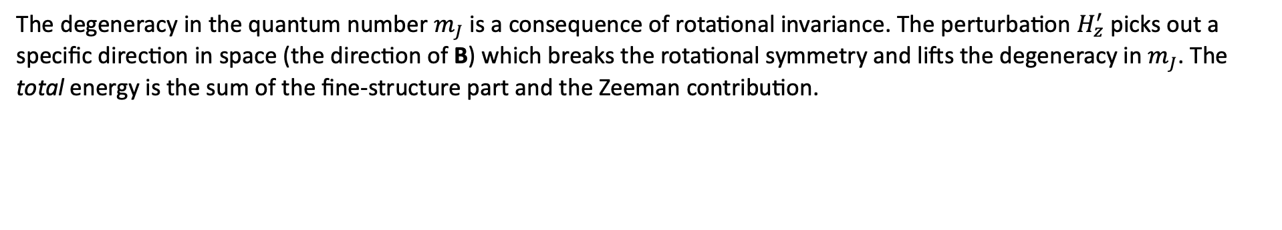
Weak-Field Zeeman Effect
Therefore
The term in square brackets is the Landé g-factor, $g_{J}$. The energy corrections are then
Bohr’s magneton
$m_{J}$ replaces $\left\langle J\right\rangle$ as we align the magnetic field B along the z axis
The degeneracy in the quantum number $m_{J}$ is a consequence of rotational invariance. The perturbation $H_{z}^{′}$ picks out a specific direction in space (the direction of B) which breaks the rotational symmetry and lifts the degeneracy in $m_{J}$. The total energy is the sum of the fine-structure part and the Zeeman contribution.
$$+$$

Slide 8
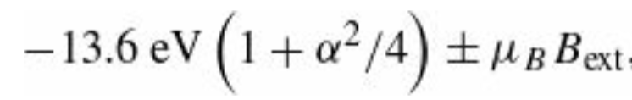
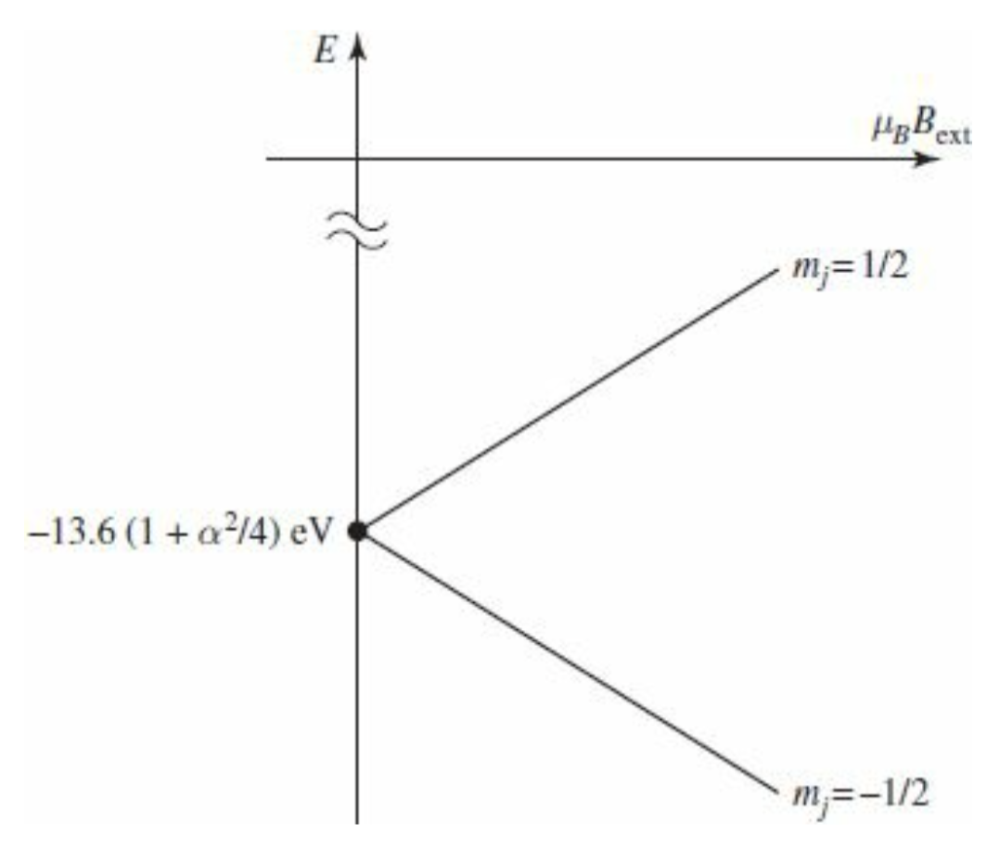
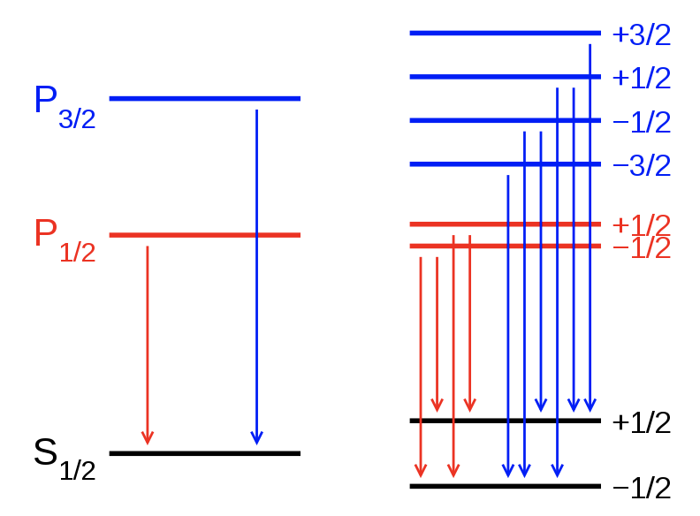
Weak-Field Zeeman Effect
For example, the ground state ($n=1, l=0, j=1/2$and therefore $g_{J}=2$) splits into two levels
with the plus sign for $m_{J}=1/2$ and minus for $m_{J}=−1/2$. These energies are plotted below for higher $n$ as well

Slide 9
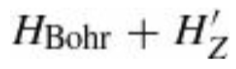
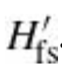
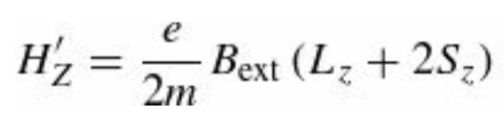
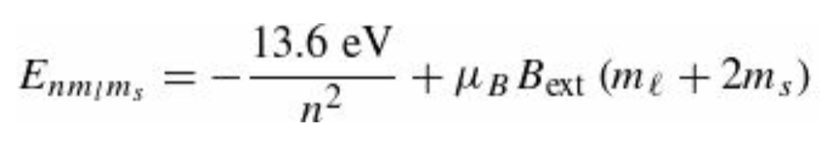
Strong-Field Zeeman Effect
If $B_{ext}≫B_{int}$ the Zeeman effect dominates, and we take the “unperturbed” Hamiltonian to be $H_{Bohr}+H_{z}^{′}$ and the
perturbation is $H_{fs}^{′}$
$$+$$
Again, we ignore QED loop effects for now
The Zeeman Hamiltonian is
and it is straightforward to compute the “unperturbed” energies
The states we are using here are $|\left.nlm_{l}m_{s}\right\rangle$ and are degenerate, since the energy does not depend on $l$ and there is an additional degeneracy due to the fact that, for example, $m_{l}=3$ and $m_{s}=−1/2$; and $m_{l}=1$ $m_{s}=1/2$ have the same energy.

Slide 10
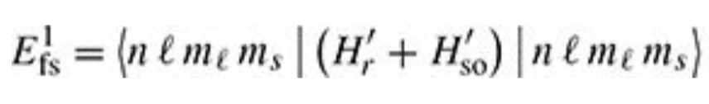
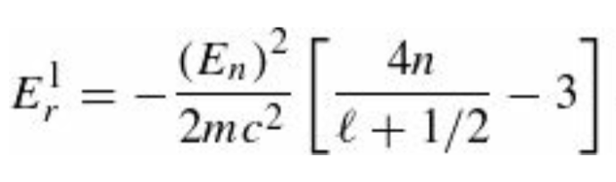
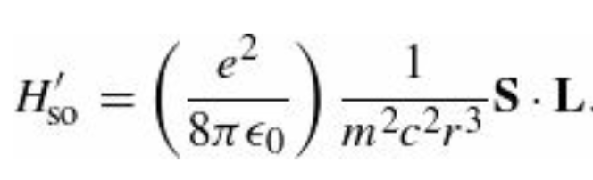
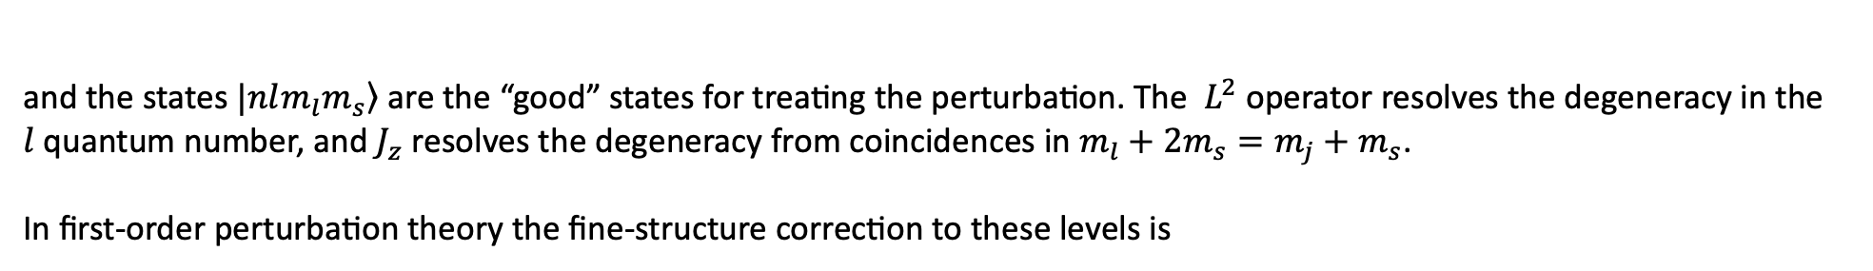
Strong-Field Zeeman Effect
But we are lucky again as we have that
$$\left[H_{fs}^{′},J_{z}\right]=0; \left[H_{fs}^{′},L^{2}\right]=0$$
and the states $|\left.nlm_{l}m_{s}\right\rangle$ are the “good” states for treating the perturbation. The $L^{2}$ operator resolves the degeneracy in the
$l$ quantum number, and $J_{z}$ resolves the degeneracy from coincidences in $m_{l}+2m_{s}=m_{j}+m_{s}$.
In first-order perturbation theory the fine-structure correction to these levels is
The relativistic contribution $E_{r}^{1}$ is the same as before, and for the spin-orbit $H_{SO}^{′}$ term
we need
$\left\langle L_{x}\right\rangle =\left\langle L_{y}\right\rangle =\left\langle S_{x}\right\rangle =\left\langle S_{y}\right\rangle =0$ for eigenstates of $L_{z}$ and $S_{z}$

Slide 11
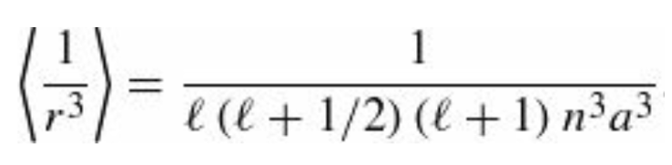
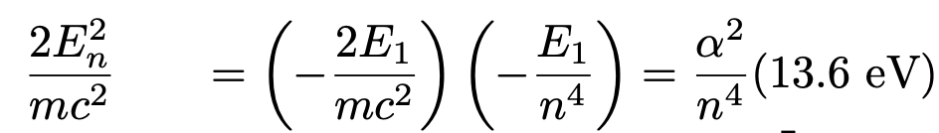
Strong-Field Zeeman Effect
Putting all this together
where we used
Massaging the coefficients in front of each of the two terms as shown below
We obtain

Slide 12
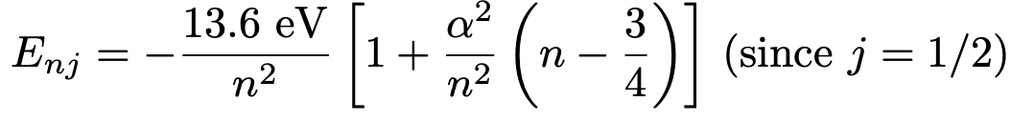
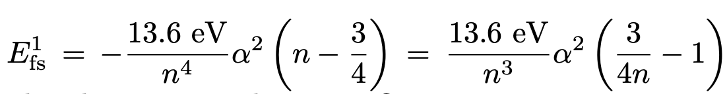
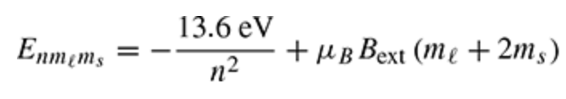
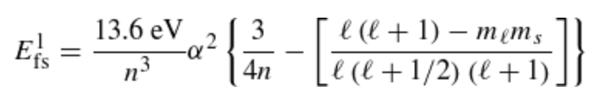
Strong-Field Zeeman Effect
Note that the term in square brackets is indeterminate for $l=0$. Its correct value in this case is 1, in fact:
$←$ same as the Zeeman term with $m_{l}=0$
$←$ from fine structure
The total energy is the sum of the Zeeman part
and the fine-structure contribution

Slide 13
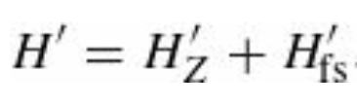
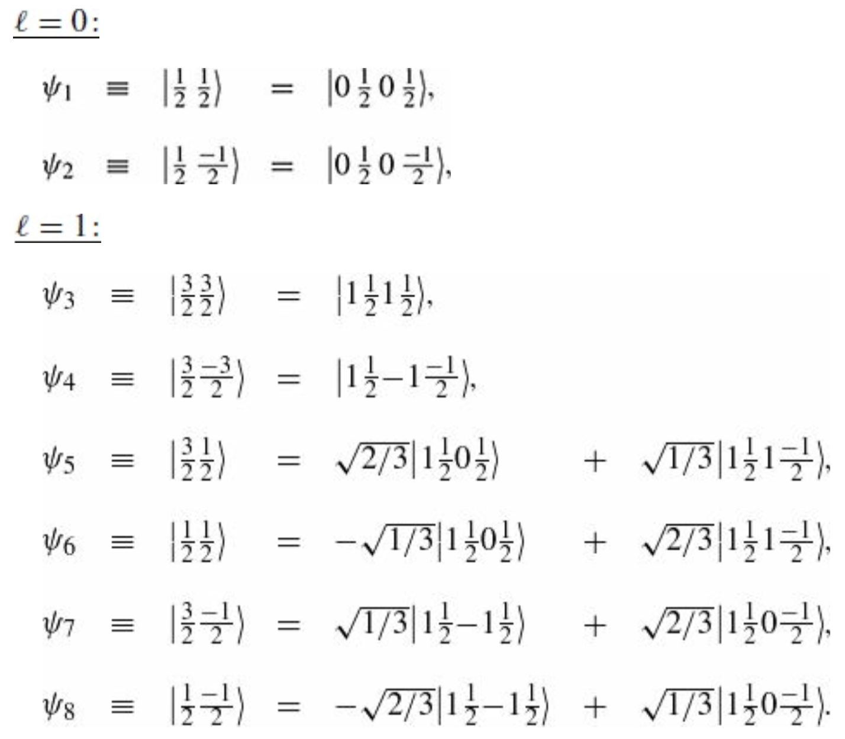
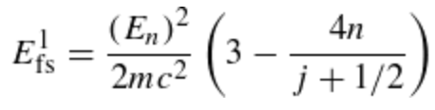
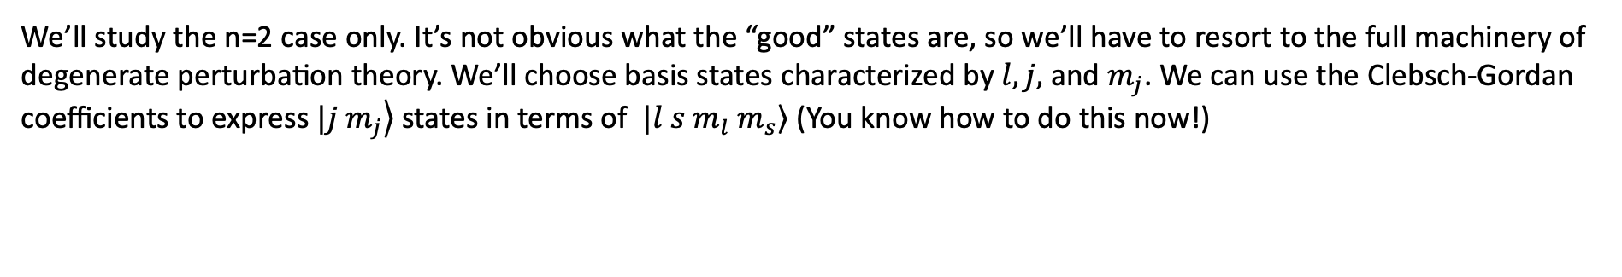
Intermediate-Field Zeeman Effect
In the intermediate regime $H_{z}^{′}$ and $H_{fs}^{′}$ have the same magnitude and we must treat them on the same footing as perturbations to the Bohr Hamiltonian
We’ll study the n=2 case only. It’s not obvious what the “good” states are, so we’ll have to resort to the full machinery of
degenerate perturbation theory. We’ll choose basis states characterized by $l, j,$and $m_{j}$. We can use the Clebsch-Gordan
coefficients to express $|\left.j m_{j}\right\rangle$ states in terms of $|\left.l s m_{l} m_{s}\right\rangle$ (You know how to do this now!)
In this basis, the nonzero matrix elements of $H_{fs}^{′}$ are on the diagonal and
given by equation
relativistic corr. + spin-orbit interact
while $H_{z}^{′}$ instead has four non-diagonal elements.
We can verify this observing that:

Slide 14
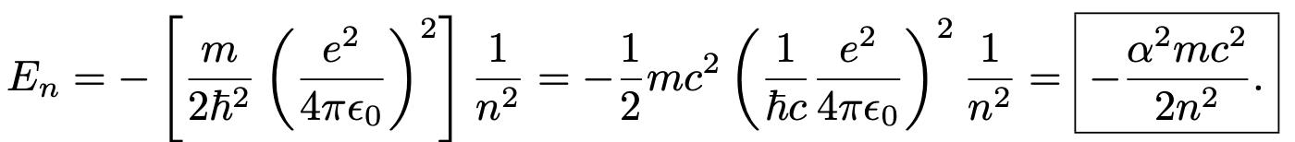
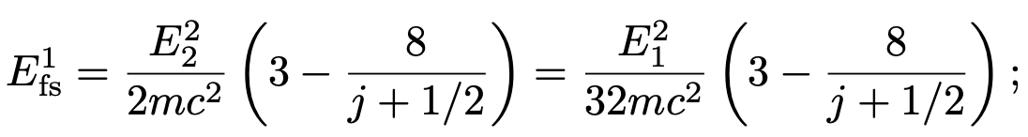
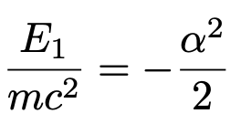
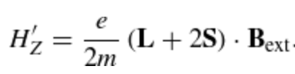
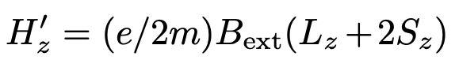
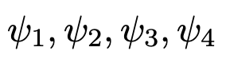
Intermediate-Field Zeeman Effect
Bohr’s energies
n=2
But
$H_{z}^{′}$ instead has four non-diagonal elements:
are eigenstates of $L_{z}$ and $S_{z}$. For these there are only diagonal elements:

Slide 15
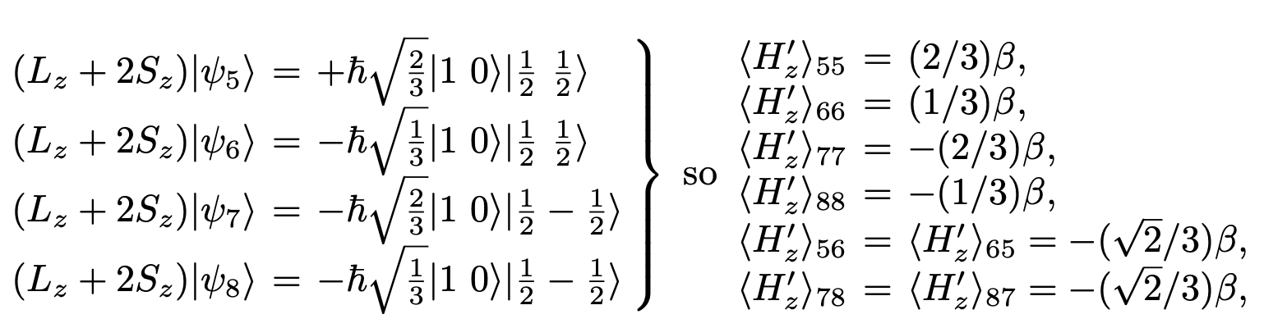
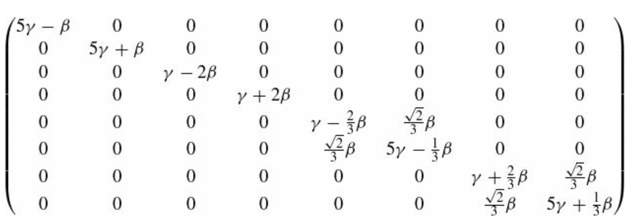

Intermediate-Field Zeeman Effect
The remaining elements of the $W$ are obtained observing that
which confirms they are non diagonal. The complete $W$ matrix is going to be
where

Slide 16




Intermediate-Field Zeeman Effect
The first four eigenvalues are already displayed along the diagonal; it remains only to find the eigenvalues of the two
2 x 2 blocks. The characteristic equation for the first of these is
and the quadratic formula gives the eigenvalues:
The eigenvalues of the second block are the same, but with the sign of β reversed. The eight energies are listed in the Table below, and plotted against $B_{ext}$
In the zero-field limit $β=0,$they reduce
to the fine structure values.

Slide 17




Hyperfine splitting of the hydrogen atom
The proton itself constitutes a magnetic dipole, though its dipole moment is much smaller than the electron’s, because of the mass in the denominator:
(The proton is a composite structure, made up of quarks and gluons, and its gyromagnetic ratio is not as simple as the electron’s—hence the explicit g-factor $g_{p}$ whose measured value is 5.59 as opposed to 2.00… for the electron.) According to classical electrodynamics, a dipole $μ$ sets up a magnetic field
So, the Hamiltonian of the electron, in the magnetic field due to the proton’s magnetic dipole moment, is

Slide 18




Hyperfine splitting of the hydrogen atom
According to perturbation theory, the first-order correction to the energy is the expectation value of the perturbing Hamiltonian:
That is
In the ground state (or any other state for which $l=0$) the wave function is spherically symmetric, and the first expectation
value vanishes. In fact, we observe the following. Let’s define integral $I$ as
where:
and

Slide 19




Hyperfine splitting of the hydrogen atom
So only three terms survive
Then we observe that
and we obtain

Slide 20





Hyperfine splitting of the hydrogen atom
For states with $l = 0$, the wave function is independent of $θ$ and $φ$: $Y_{00}= 1/ 4π$, therefore,
The first angular integral is 3(4π/3)(Sp · Se) = 4π(Sp · Se), while the second is − (Sp · Se) $∫$sin θ dθ dφ = −4π(Sp · Se), so the two cancel, and the result is zero.
Meanwhile
And one finds that
in the ground state. This is called spin-spin coupling, because it involves the dot product of two spins (contrast spin-orbit coupling, which involves $S∙L$). In the presence of spin-spin coupling, the individual spin angular momenta are no longer conserved; the “good” states are eigenvectors of the total spin,

Slide 21





Hyperfine splitting of the hydrogen atom
As before, we square the previous expression out to get
But the electron and proton both have spin 1/2, so
In the triplet state (spins “parallel”) the total spin is 1, and hence
in the singlet state the total spin is 0, and
Therefore, we have that
Spin-spin coupling breaks the spin degeneracy of the ground state, lifting the triplet configuration and depressing the singlet.

Slide 22




Hyperfine splitting of the hydrogen atom
The energy gap is
The frequency of the photon emitted in a transition from the triplet to the singlet state is
The corresponding wavelength is 21cm, which falls in the microwave region. This famous 21cm line is among the most
pervasive forms of radiation in the universe.
A hydrogen atom with proton and electron spins aligned (top) undergoes a flip of the electron spin, resulting in emission of a photon with a 21 cm wavelength (bottom)

Slide 23
Hyperfine splitting of the hydrogen atom
An atom of neutral hydrogen consists of an electron bound to a proton. The lowest stationary energy state of the bound electron is called its ground state. Both the electron and the proton have intrinsic magnetic dipole moments ascribed to their spin, whose interaction results in a slight increase in energy when the spins are parallel, and a decrease when antiparallel. The fact that only parallel and antiparallel states are allowed is a result of the quantum mechanical discretization of the total angular momentum of the system.
When the spins are parallel, the magnetic dipole moments are antiparallel (because the electron and proton have opposite charge), thus one would expect this configuration to actually have lower energy just as two magnets will align so that the north pole of one is closest to the south pole of the other.
This logic fails here because the wave functions of the electron and the proton overlap; that is, the electron is not spatially displaced from the proton, but encompasses it. The magnetic dipole moments are therefore best thought of as tiny current loops. As parallel currents attract, the parallel magnetic dipole moments (i.e., antiparallel spins) have lower energy.
The hyperfine splitting in hydrogen has been used to measure the value of the fine-structure constant α. Comparison with measurements of α in other physical systems provides a stringent test of QED.

